Slide 1
Microsoft Azure Virtual Machines
Microsoft Research
Microsoft Azure for Research Training

Slide 2
Virtual Machines
Learning objectives – what you will learn:
Wide variety of pre-configured virtual machines available from the gallery
How to make your own virtual machine from an existing installation
An example using Windows and Visual Studio
An example using Linux and IPython notebook

Slide 3
Agenda
IaaS recap (Infrastructure as a Service)
Provisioning VMs in the cloud
Windows and Linux VMs
VM gallery
VM sizes and reliability
VM disks and images
Demos
Notes:
Slide Objectives:
Introduce the topics that will be covered in this session
VALUE PROP
Speaking Points:
Notes:

Slide 4
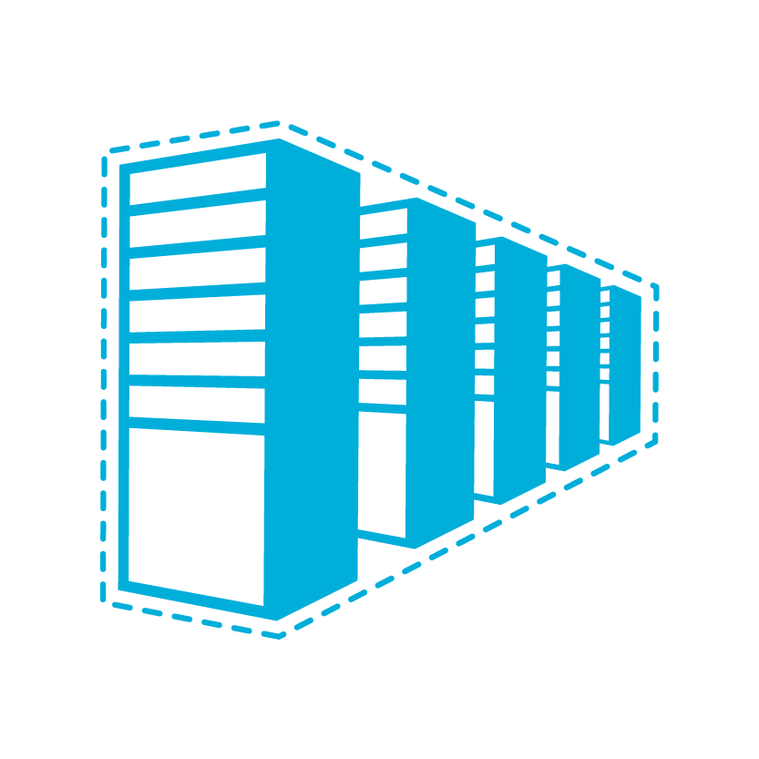


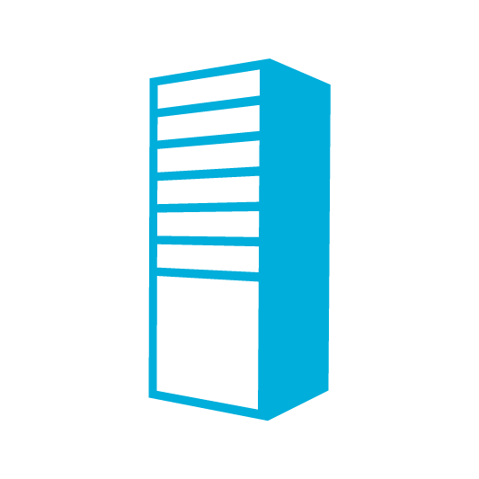

A Continuous Offering From Private to Public Cloud
Physical
Virtual
IaaS
PaaS
SaaS
Notes:
Slide Objective:
Microsoft provides a continuous solution from private cloud to the public cloud. No matter where you are on your technology roadmap we have a solution to fit your needs.
We are a trusted advisor and platform in the traditional enterprise and ISV space and with the new IaaS offering we are making it easier to bring this same level of trust and ease of use to the public cloud.

Slide 5


Cloud-First Provisioning of VMs
Getting Started
Select Image and VM Size
New Disk Persisted in Storage
Windows Server
Management Portal
Boot VM from New Disk
Linux
>_
A0
A1
A2
A3
A4
A5
A6
A7
Scripting
(Windows, Linux and Mac)
Cloud
REST API
Notes:
Slide Objective:
Explain workflow for provisioning VMs in the cloud
Notes:
Cloud First Provisioning means exactly what is says. Building a VM in the cloud first.
You have three methods of starting this process: Build a VM from the portal, from the command line OR programmatically calling the REST API.
Once your choice of provisioning is made you will need to select the image and instance size to start from.
The newly created disk will be stored in blob storage and your machine will boot.

Slide 6
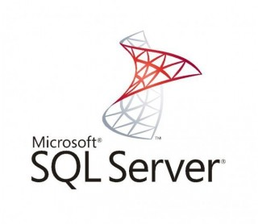
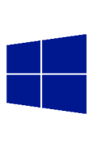
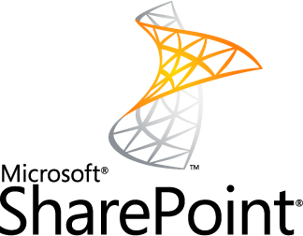
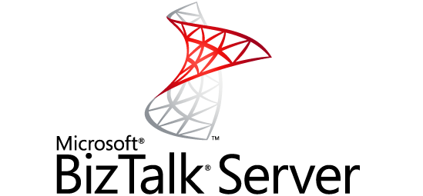
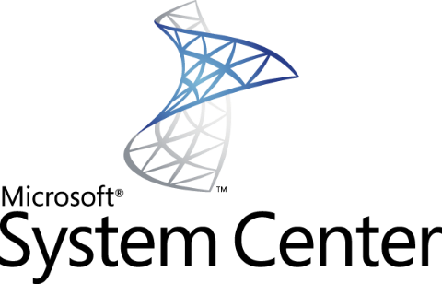
Microsoft Images
SQL Server 2008 R2
SQL Server 2012 SP1
SQL Server 2014
Windows Server 2008 R2
Windows Server 2012 R2
SharePoint 2010 & 2013
BizTalk 2010 & 2013
System Center 2012
http://support.microsoft.com/kb/2721672
Notes:
Windows Server Windows Server 2008 R2 and later versions are supported for the following roles:
Active Directory Domain Services
Active Directory Federation Services
Active Directory Lightweight Directory Services
Application Server
DNS Server
Fax Server
Network Policy and Access Services
Print and Document Services
Web Server (IIS)
Windows Deployment Services
Windows Server Update Services
File Services

Slide 7






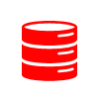

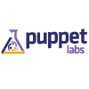
Linux & Oracle Images
Ubuntu 12.04.1+, 14.04 & 14.10
OpenLogic CentOS 6.3+
OpenSUSE 13.1+
SUSE Linux Enterprise Server 11 SP3+
Oracle Linux 6.4+ Oracle Database 11gR2/12c Oracle WebLogic 11g R2/12c Java JDK 6/7
Puppet Enterprise 3.2.3 / 3.7.2
Notes:
Slide Objectives:
Provide an understanding of which Distributions of Linux are offered in the Microsoft Azure Image Gallery.
Notes:
Linux Virtual Machines Product Page: http://www.windowsazure.com/en-us/manage/linux

Slide 8
Datacenter Configuration
High Bandwidth
DC Network
Compute Cluster:
Gen2
Compute Cluster:
Gen3
Storage Cluster:
Standard
Compute Cluster:
Gen2 - HighMem
Compute Cluster:
Gen4 – G
Storage Cluster:
Premium
Compute Cluster:
Gen2.5 - RDMA
Notes:
Gen2 hardware supports VM sizes from A0 – A4. The higher memory A-series VMs are not supported on this hardware because each physical node only contains 32GB of RAM.

Slide 9
Datacenter Configuration
Compute Cluster:
Gen2 – High Mem
The A family
A
Highest value VM Size
General Purpose
Higher Memory Options
Standard_A0 – Standard_A7
Basic_A0 – Basic_A4
Notes:
The HighMem version of Gen2 hardware contains 64GB of RAM per physical nodes which allows for the A-Series VMs with higher memory to core ratio (A5, A6 and A7) to be hosted on these servers along with the lower memory A-Series of VMs

Slide 10
Datacenter Configuration
Compute Cluster:
Gen2.5 – RDMA
The A family
A
High Performance RDMA
Higher Performance CPUs
Local Storage: Magnetic
Standard_A8 – Standard_A9
Standard_A10 - Standard_A11 (Coming soon w/o RDMA)
Notes:
The Gen2.5 hardware also known as HPC hardware internally should technically have been considered a new family. The CPUs of this hardware are the same generation as the CPUs in the Gen3 hardware, and the frequency of the hardware is higher than the Gen3 hardware. This hardware also has Infiniband RDMA network cards for very low latency VM-to-VM connections when using the MPI libraries. However this hardware does not have local SSDs so we do not classify it as a variation of the D-Series of VMs
Under NDA: We will be releasing a set of VM sizes on this hardware called Standard_A10 and Standard_A11 which will offer these high quality CPUs without the RDMA network card. This will allow for lower prices for CPU sensitive workloads.

Slide 11
Datacenter Configuration
Compute Cluster:
Gen3
The A family
The D family
A
D
Highest value VM Size
Basic and Standard Sizes
Higher Memory Options
60% faster CPU
Up to 112 GB Memory
Local SSD storage
Standard_A0 – Standard_A7
Basic_A0 – Basic_A4
Standard_D0 – Standard_D14
Notes:
Gen3 hardware supports the A-Series (except A8 – A11) and D-Series of VM sizes.
The CPU in this hardware is a later generation than the CPU used in Gen2 hardware, and it is the same CPU family (Sandy Bridge) that is used in the Gen2.5 (HPC) hardware. The CPU frequency in this hardware is lower than the CPU frequency of the Gen2.5 (HPC) hardware.
When running a A-Series VM on this hardware the CPU cycles will be throttled to provide equivalent CPU horsepower as the Gen2 and Gen2-HighMem clusters.

Slide 12
Datacenter Configuration
Compute Cluster:
Gen3 - G
The G family
G
Optimized for data workloads
Up to 32 CPU cores, 448 GB RAM, 6.5 TB local SSD
Latest generation Intel processor
Standard_G1 – Standard_G5
Notes:
The G-Series of VMs are the latest and largest VM sizes available in Azure.
There is more RAM and local SSD space per core on these VMs than any other VM Size in the A or D Series
The CPUs are two generations past the CPUs used in the Gen3 hardware (Haswell vs. Sandy Bridge) which leads to more CPU power per core than any earlier hardware.
However the A8 – A11 VMs are very close to the CPU horsepower of the G-Series because the A8 – A11 run at 2.9 GHz while the G1 – G5 VMs run at 2.0 GHz
For some CPU-bound workloads the A8 – A11 may be better due to the higher frequency

Slide 13
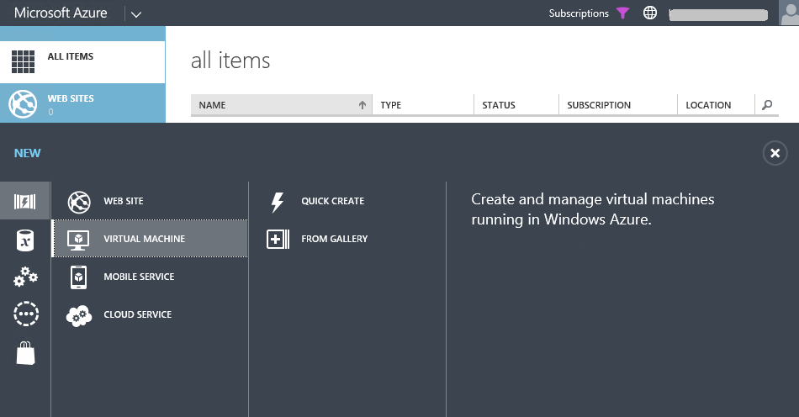
Create a VM from the Microsoft Azure portal

Slide 14
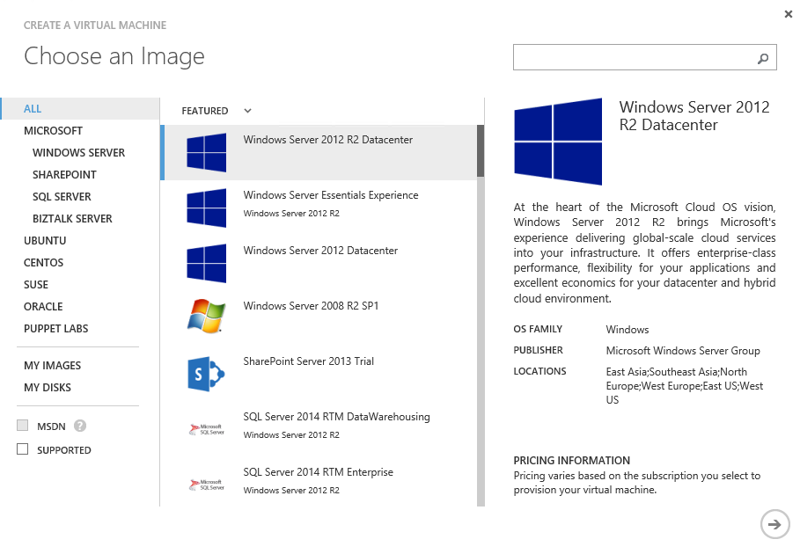

Slide 15
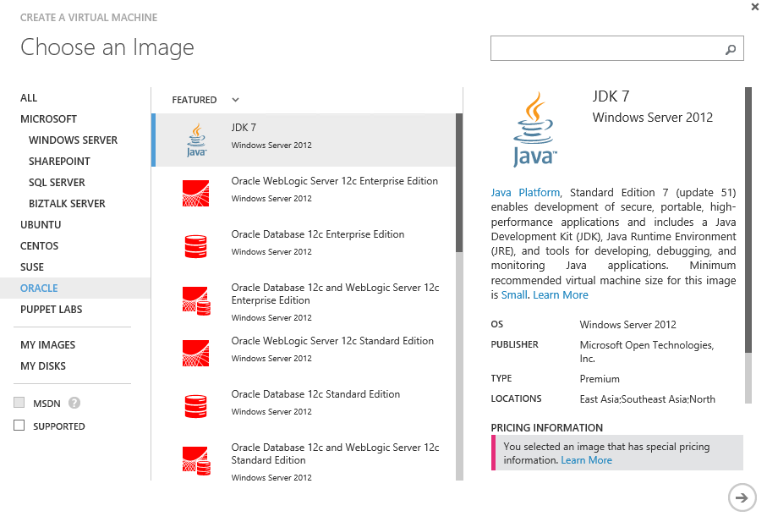

Slide 16
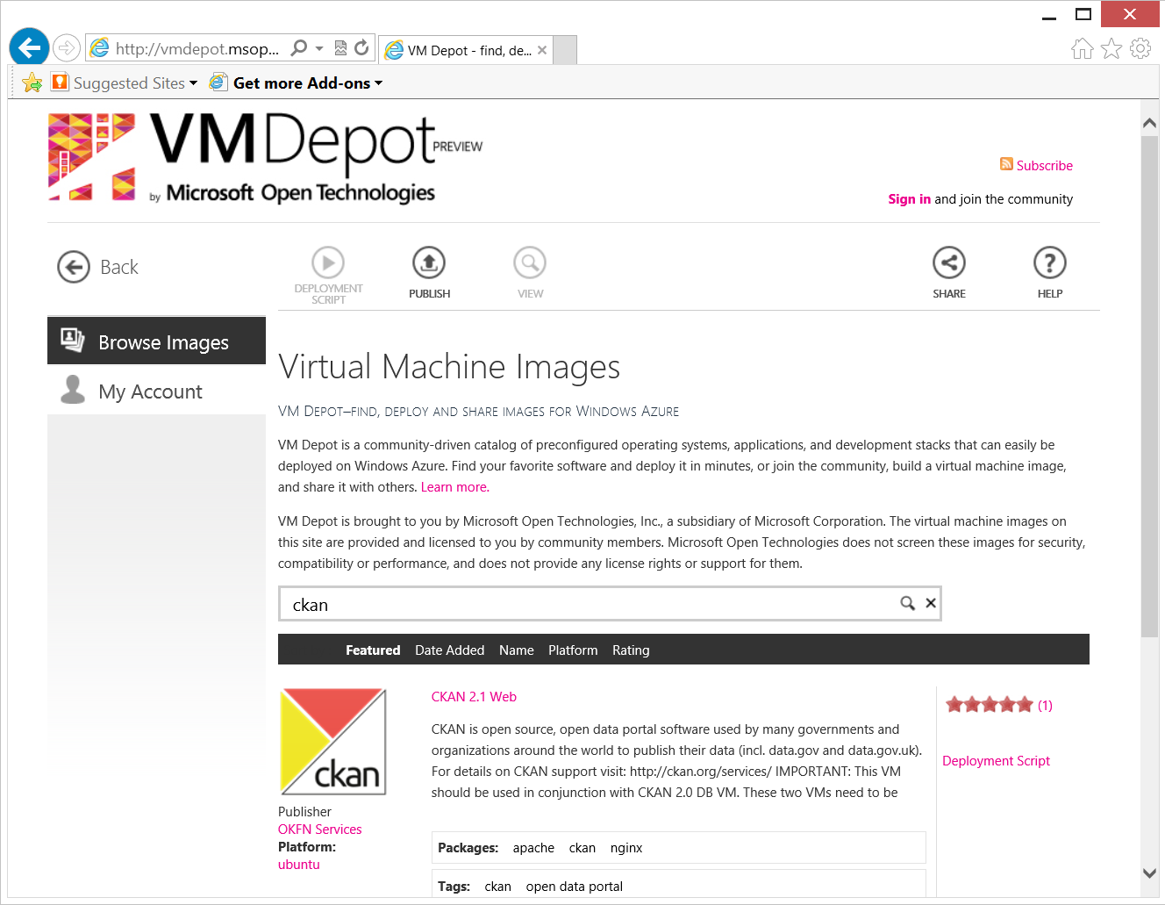
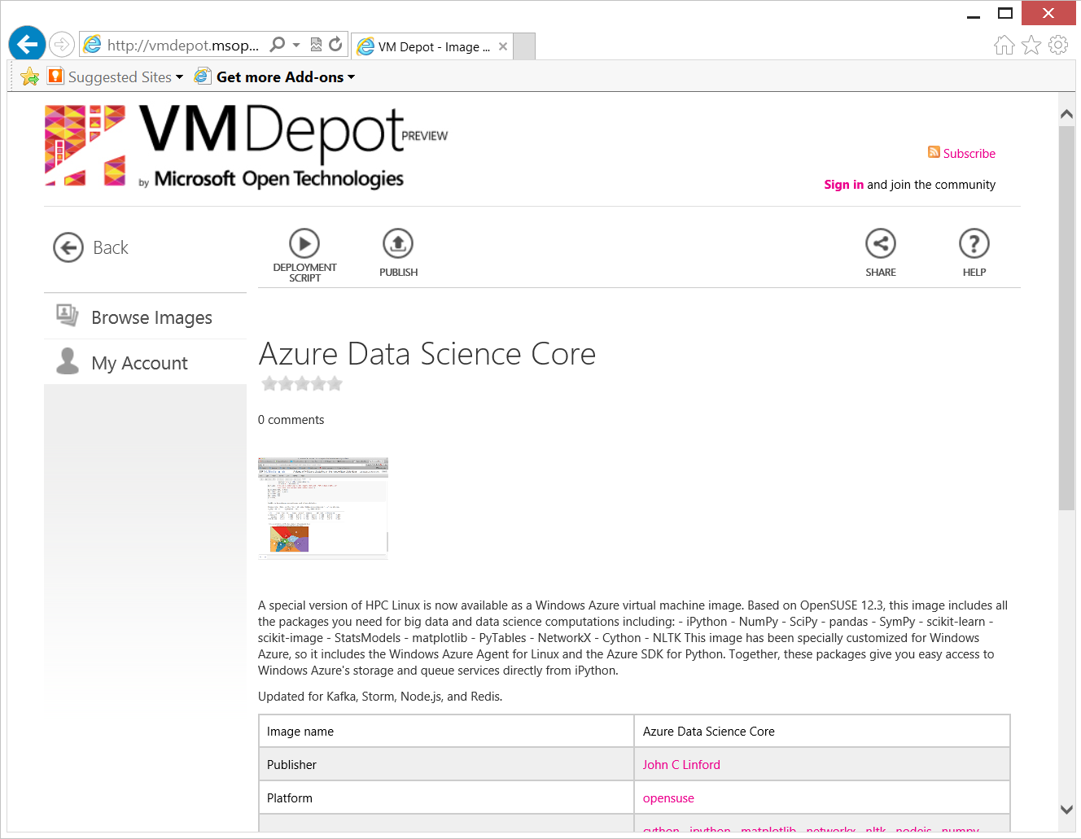
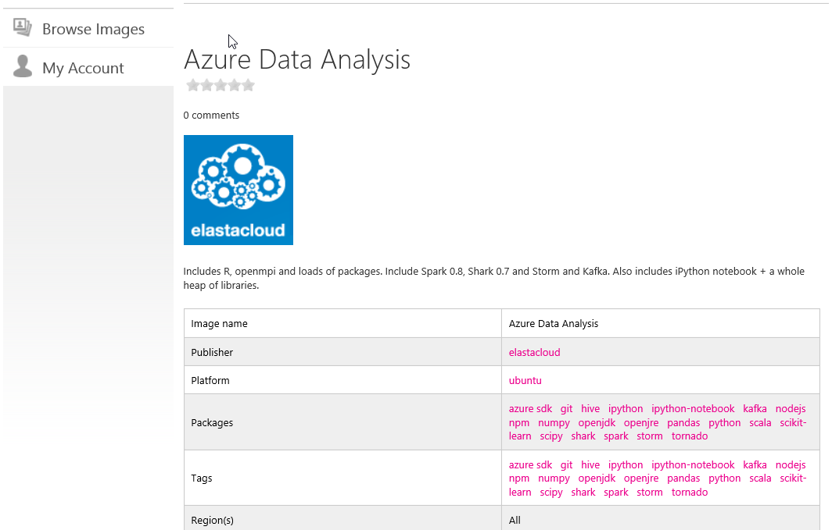
Linux Virtual Machines from the VMDepot
Notes:
http://vmdepot.msopentech.com/Vhd/Show?vhdId=8689&version=9728

Slide 17
Virtual Machines Availability

Slide 18

Service Level Agreements
Availability set
99.95% for multiple role instances
4.38 hours of downtime per year
Server 1
Server 2
What’s included
Compute Hardware failure (disk, cpu, memory)
Datacenter failures - Network failure, power failure
Hardware upgrades, Software maintenance – Host OS Updates
What is not included
VM Container crashes, Guest OS Updates
SLA 99.95
Notes:
Slide Objective:
You need an availability set for a 99.95% SLA
Notes:
Without at least two virtual machines performing the same workload grouped into an availability set you get a 99.95% SLA.

Slide 19
Fault and Update Domains
Fault Domains
Represent groups of resources anticipated to fail together
i.e. Same rack, same server
Fabric spreads instances across fault at least 2 fault domains
Update Domains
Represents groups of resources that will be updated together
Host OS updates honour service update domains
Specified in service definition
Default of 5 (up to 20)
Fabric spreads role instances across Update Domains and Fault Domains
Notes:
Slide Objective:
Discuss achieving very high availability with Microsoft Azure
Notes:
Fault Domain is a physical unit of failure, and is closely related to the physical infrastructure in the data centers.
In Microsoft Azure the rack can be considered a fault domain. However there is no 1:1 mapping between fault domain and rack.
Microsoft Azure Fabric is responsible to deploy the instances of your application in different fault domains.
Obviously this only applies if you run more than 1 instance
Right now Fabric makes sure that your application uses at least 2 (two) fault domains, however depending on capacity and VM availability it may happen that it is spread across more than that.
As a developer u have no direct control over how many fault domains your application will use but the way you configure it may impact your availability
Upgrade Domain is a logical unit, which determines how particular service will be upgraded.
The default number of upgrade domains that are configured for your application is 5 (five). You can control how many upgrade domains your application will use through the upgradeDomain configuration setting in your service definition file (CSDEF).
Microsoft Azure Fabric ensures that particular upgrade domain is not within single fault domain
That is Upgrade domains are orthogonal to fault domains
Roles are then spread out over upgrade domains and fault domains. Subject to running a reasonable number of instances this removes the risk of a single point of failure

Slide 20
Virtual Machine Availability Sets Update Domains are honored by host OS updates
Fault Domain
Fault Domain
Rack
Rack
Virtual Machine
Virtual Machine
Availability Set
IIS1
IIS2
UD #1
UD #2
Availability Set
Virtual Machine
Virtual Machine
SQL1
SQL2
UD #1
UD #2
Notes:
Slide Objective:
Explain availability sets
Notes:
Availability sets tell the Fabric Controller to place VMs in the same set on different racks for faults and in separate upgrade domains for updates.
This essentially tells the FC not to take the guest OS down of all VMs in the same set for host updates.

Slide 21
Virtual Machine Data Disks

Slide 22
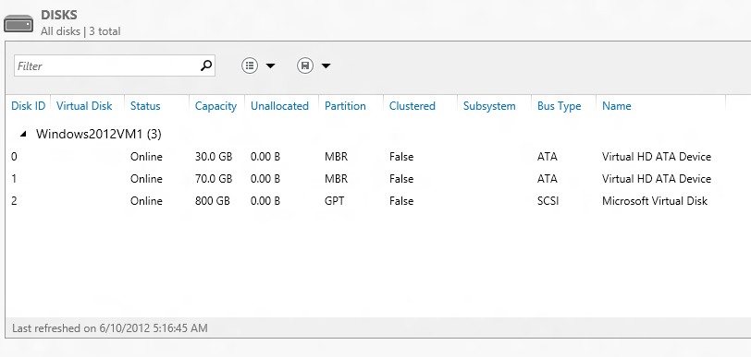
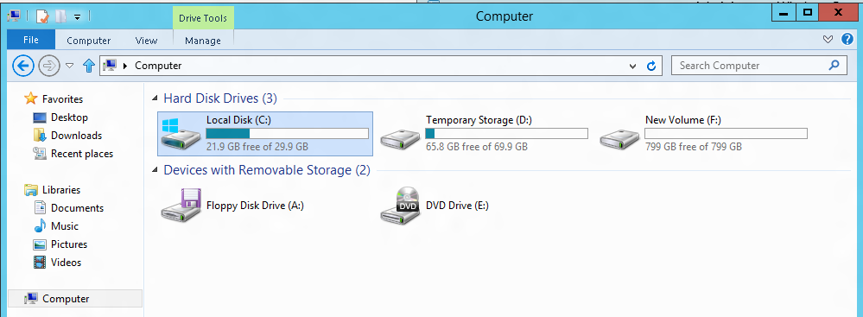
VM disk layout
OS Disk
Persistent
SATA
Drive C:

Slide 23
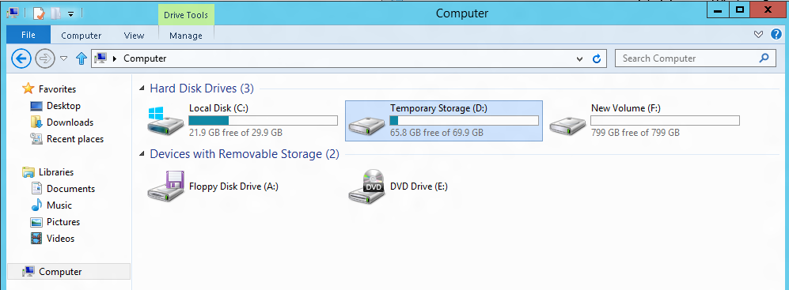
VM disk layout
Temporary Storage Disk
Local (Not Persistent)
SATA
Drive D:

Slide 24
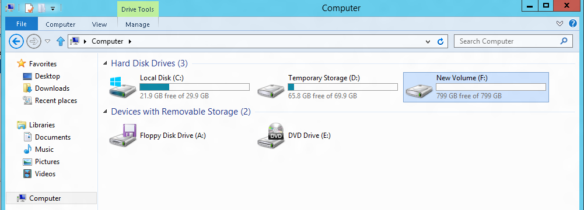
VM disk layout
Data Disk(s)
Persistent
SCSI
Customer Defined Letter

Slide 25
Persistent Disk Management
Capability | OS Disk | Data Disk
Host Cache Default | ReadWrite | None
Max Capacity | 127 GB | 1 TB
Imaging Capable | Yes | No
Hot Update | Cache Setting Requires Reboot | Change Cache Without Reboot, Add/Remove without Reboot.
C:\ = OS Disk
D:\ = Non-Persistent Cache Disk
E:\, F:\, G:\ ... Data Disks
Notes:
Slide Objective:
Highlight the differences in default cache policy between the OS disk and DataDisk

Slide 26
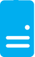
Persistent Disks and Highly Durable
Microsoft Azure Storage (Disaster Recovery)
Microsoft Azure Storage
Virtual Machine
Notes:
Slide Objective:
Explain how disks are durable and how Microsoft Azure storage works
Notes:
The OS and Data Disks are stored in Microsoft Azure storage. So in addition to the data being persistent you also get the benefits of storage which means your VHD is replicated 3X’s locally and also 3X’s in a separate data center in the same region (geo-replication)

Slide 27
Persistent Disks and Highly Durable
Microsoft Azure Storage (Disaster Recovery)
Microsoft Azure Storage
Virtual Machine
Virtual Machine
Notes:
Slide Objective:
This slide simply highlights that if the physical hardware backing your VM goes down a new server will start and pick up the same VHD.

Slide 28
Virtual Machines Images

Slide 29
Disks and Images
OS Images
Microsoft
Partner
User
Base OS image for new Virtual Machines
Sys-Prepped/Generalized/Read Only
Created by uploading or by capture
Disks
OS Disks
Data Disks
Writable Disks for Virtual Machines
Created during VM creation or during upload of existing VHDs.
Notes:
Slide Objective:
Explain the differences between disks and images with VMs

Slide 30
Image Mobility
On-Premises
Cloud
MyApp.vhd
Notes:
Slide Objective:
Explain the benefits of image mobility
Notes:
One of the key benefits of IaaS is flexibility and control. The Microsoft Azure solution provides the capability of not only moving VHDs TO the cloud but also allows you to copy the VHD back down and run it locally or on another cloud provider. Great for testing out production issues or any other need where you require a copy of the production server.

Slide 31
Bring Your Own Server/VHD
On-Premises
Cloud
MyApp.vhd
On Premises Virtual Server
Provision VM from Image or Disk using portal, script or API
Use Case
Forklift Migration of VMs
Sys Prepped Images
VHD Must Be Fixed Disk
* CSUpload Can Convert on Upload
Upload VHD
Create Disk or
Image
Notes:
Slide Objective:
Explain workflow for bringing your own VHD
Notes:
This use case is when you already have a “golden image(s)” your company uses for server provisioning or you have a VM running on premises that you would just like to run in our data center. You take the vhd – use CSUpload or System Center App Controller to upload as a page blob to a storage account. From there use the portal to add as an image (sysprepped) or disk (configured VM) and there you can create a VM based off of the vhd.

Slide 32
Gallery Experience
Lowest barrier of entry
Partner created images
Click through provisioning
Leverage portal to:
Provide Images (VHDs that include ICs and agent)
Associate SSH Keys
Collect configuration information
Drive provisioning
Notes:
Slide Objectives:
Provide context for functionality available in the Gallery experience

Slide 33

Bring Your Own Linux
Expert Customers that want to tweak, customize, create images based on supported distributions
Customer will
Use Hyper-V to install Distribution
Add ICs and Agent
Generate the VHD
Capture configuration
Generate resources
Upload and start instance
Linux Native: Tools, libraries, scripts
Notes:
Slide Objectives:
Explain the process around Bring-Your-Own-Linux VHD which supports customized images created in Hyper-V
Notes:
Tutorial on WindowsAzure.com: http://www.windowsazure.com/en-us/manage/linux/common-tasks/upload-a-vhd/

Slide 34
Create a Windows VM
HOL
Notes:
1 – simple Example
2 – Real world – KINECT!

Slide 35
Create a Linux VM
HOL
Notes:
1 – simple Example
2 – Real world – KINECT!

Slide 36
The platform image gallery
HOL
Notes:
1 – simple Example
2 – Real world – KINECT!

Slide 37
Using VM Depot
HOL
Notes:
1 – simple Example
2 – Real world – KINECT!

Slide 38
Adding Data Disks to a Windows and Linux VM
HOL
Notes:
1 – simple Example
2 – Real world – KINECT!

Slide 39
For the Next Lab:
Leave your VMs Running
We will be using them for the next lab.

Slide 40
Virtual Machines
Learning objectives – what we have learned:
The wide variety of pre-configured virtual machines available from the gallery
How to make your own virtual machine from an existing installation
An example using Windows and Visual Studio
An example using Linux and IPython notebook

Slide 41
Application Scenarios
Web Sites
Cloud Services
Virtual Machines
Modern web apps
Perfect if your app consists of client side markup and scripting, server side scripting and a database. Powerful capability to scale out and up as needed.
Multi-tier applications
Cloud-based applications that separate application logic into multiple tiers (i.e. caching middle tier, asynchronous background processes like order processing) using both Web and Worker Roles
Enterprise server applications
Run your existing enterprise applications in the cloud, such as SQL Server, SharePoint Server or Active Directory.
Continuous development
Deploy directly from your source code repository, using Git or Team Foundation Service.
Apps that require advanced administration
Cloud-based applications that require admin access, remote desktop access or elevated permissions
Porting existing line of business apps
Choose an image from the library or upload your own VHD.
Popular open source apps
Launch a professional looking site with a few clicks using apps like WordPress, Joomla!, Drupal, DotNetNuke and Umbraco
Apps that require advanced networking
Cloud-based applications that require network isolation for use with Microsoft Azure Connect or Microsoft Azure Virtual Network
Windows or Linux operating system
Support for Windows Server, along with community and commercial versions of Linux. Connect virtual machines with cloud services to take full advantage of PaaS services.
Notes:
Leave in appendix for QA when the question is asked.

